Slide 1



Heart Disease Diagnosis Chatbot using DifY AI
Notes:
1

Slide 2
Problem Statement
Cardiovascular diseases are a leading cause of death globally, and early detection is vital for effective treatment.
Traditional diagnostic methods can be expensive, time-consuming, and inaccessible to many.
Notes:
2

Slide 3

Objective
AI-Powered Chatbot
Accessible Diagnosis
Develop a chatbot that uses AI to diagnose heart disease early and accurately.
Provide convenient, cost-effective, and accessible heart disease diagnosis.
Notes:
3

Slide 4
Dataset Overview
Heart Disease CSV Dataset
Key Features
The dataset contains features like age, cholesterol levels, and blood pressure.
Age, cholesterol levels, and blood pressure are key indicators of heart disease risk.
Notes:
4

Slide 5
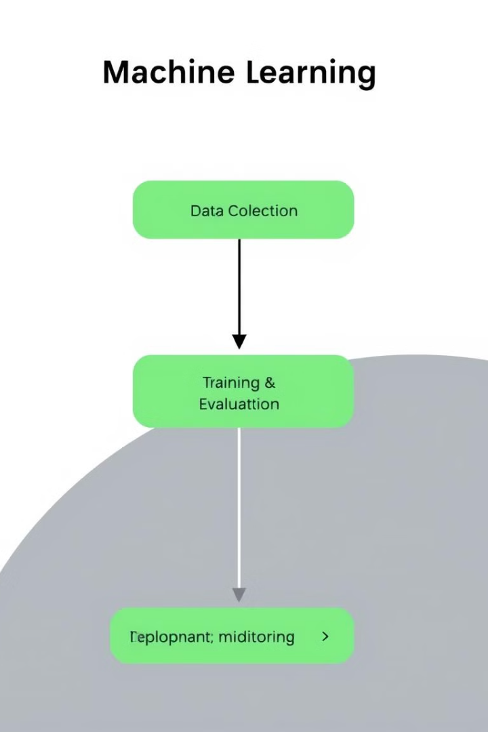
Methodology
Input
1
Users provide personal and health information through a conversational interface.
Processing
2
Machine learning models analyze user input to predict heart disease risk.
Output
3
The chatbot provides a personalized risk assessment and recommendations for further care.
Notes:
5

Slide 6

Future Scope
Advanced Features
Integration with EHR
The chatbot could recommend lifestyle changes and monitor user progress over time.
Integration with electronic health records for a more comprehensive and personalized experience.
Notes:
6

Slide 7




Key Challenges
Accuracy and Reliability
Privacy and Security
Ensuring the chatbot's predictions are accurate and reliable.
Protecting user privacy and security of sensitive health data.
User Adoption and Engagement
Encouraging user adoption and engagement with the chatbot.
Notes:
7

Slide 8



Potential Impact
Early Diagnosis
Providing timely diagnosis can lead to better health outcomes.
Reduced Healthcare Burden
Early diagnosis can potentially reduce the burden on the healthcare system.
Notes:
8

Slide 9

Conclusion
The heart disease diagnosis chatbot using DifY AI has the potential to revolutionize heart disease detection and provide a more accessible and personalized healthcare experience.
Notes:
9

Slide 10


